Slide 2
Nobody Reads The Terms & Conditions
“Clicking ‘I agree’ without reading the terms is the modern equivalent of signing a contract written in a language you don’t speak”
By =>XBEASTCODERZ

Slide 3
Our Main objective and summary
Objective :-
=> Make legal documents easy to understand for non legal users.
=>Increase awareness of hidden risks in digital agreement’
=>cut the reading time from 20 minutes to just 1 or 2 minutes .
Summary :-
=>AI based tool that reads any Terms & Conditions documents.
=>generates a shorts , plain language summary in seconds.
=>Highlights risky clauses like data sharing, auto renewable, third party links e.t.c.
=>User just paste the text to get instant results .

Slide 4
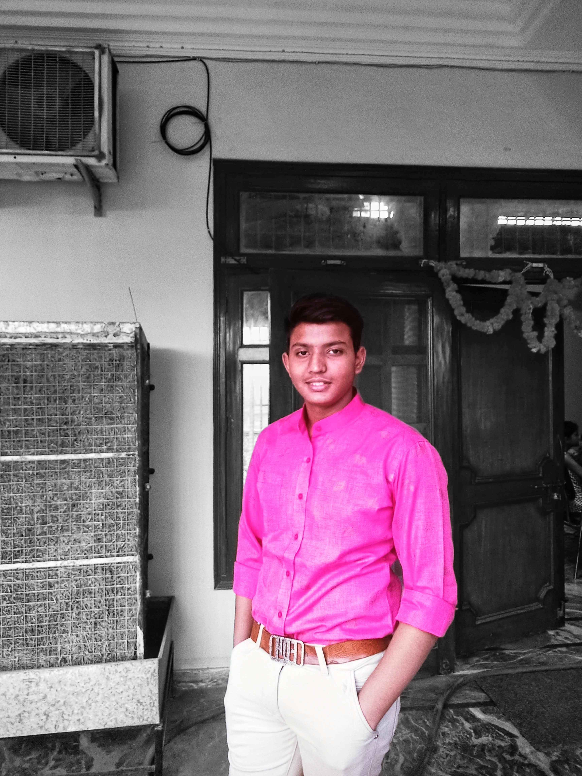
Content creator (leader)
"I am the team leader. I coordinate the project, define the overall strategy, manage the workflow, ensure smooth communication among team members, and present our solution during the final pitch.“
"Our Video Editor produces the product demonstration video by recording the application's workflow, adding transitions, captions, voice-over, animations, and editing it into a concise, impactful presentation."

Slide 5
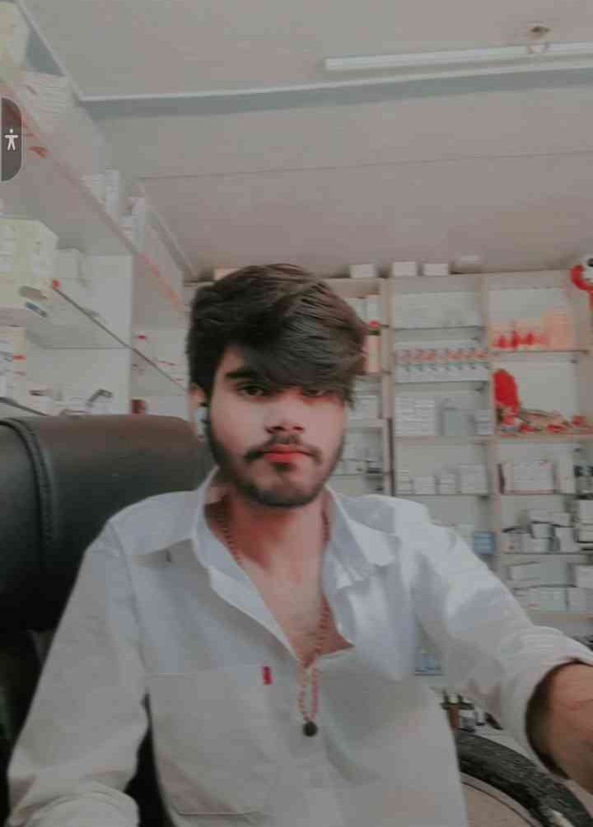
Full stack web developer
"Our Full-Stack Developer is responsible for building the complete web application. This includes developing the frontend, implementing the backend, integrating APIs and databases, and ensuring that all features work seamlessly."

Slide 6
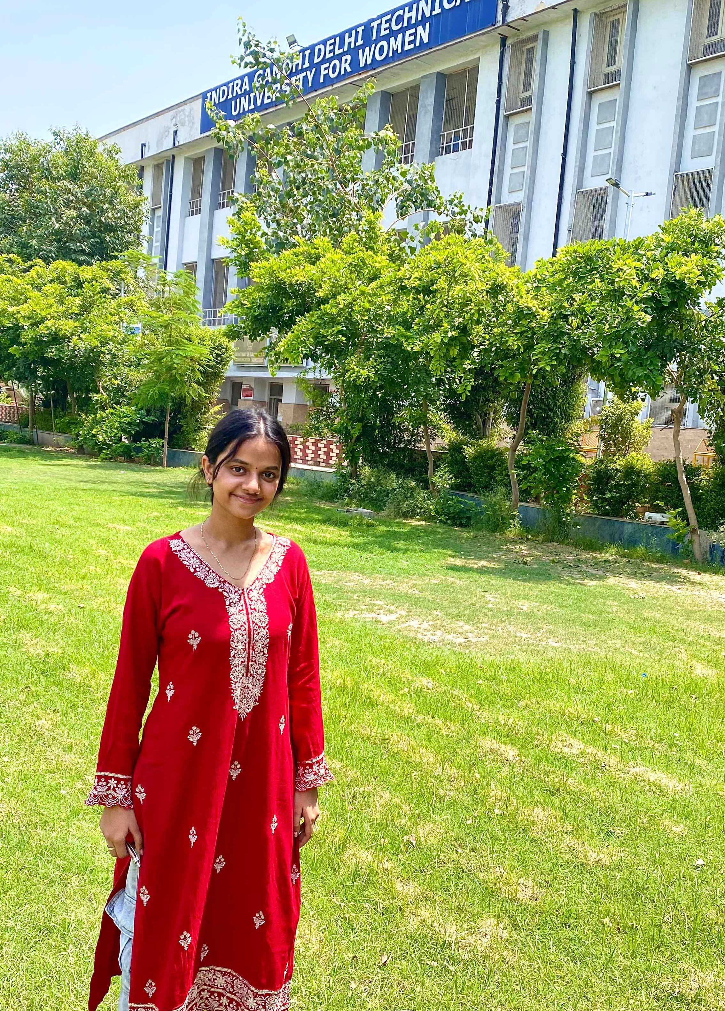
UI/UX designer
"Our UI/UX Designer focuses on creating an intuitive, visually appealing, and user-friendly interface. They conduct user flow planning, wireframing, prototyping, and ensure the application delivers a great user experience."

Slide 7
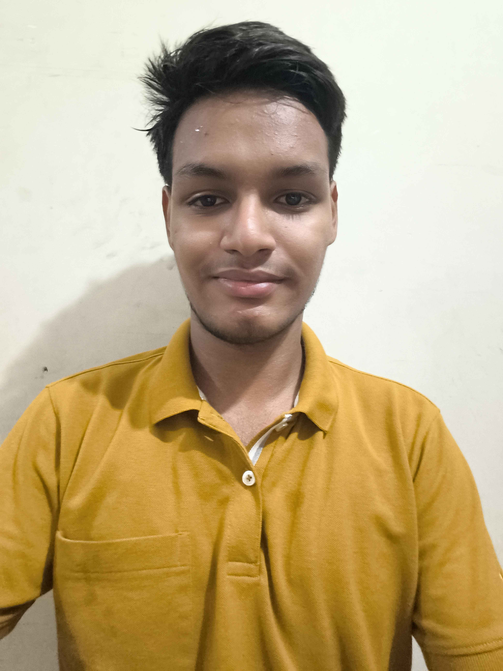
PPT designer
"Our Presentation Designer creates a professional and engaging pitch deck that clearly communicates our problem statement, solution, technical implementation, business value, and future scope to the judges.“

